Slide 1
CURRENT SITUATION OF ECVET IN TURKEY

Slide 2
WHAT IS ECVET?
ECVET is a useful tool that aims to facilitate the transfer and accumulation of learning outcomes of individuals who transition from one learning environment to another and / or from one system of qualifications to another.

Slide 3
PROGRESS OF ECVET IN EUROPE
The development of ECVET started with the Copenhagen Declaration in 2002. The relevant process has continued with Maastricht 2004, Helsinki 2006 and Bordeaux 2008, which support the establishment of a credit transfer system in vocational education and training (VET).
During this process, many steps have been taken and progress has been made related to ECVET.
Notes:
Kredi Transfer Sistemi:Öğrenme kazanımlarına dayalı çalışma yükünün sayısal olarak ifade edilmesidir.

Slide 4
PROGRESS OF ECVET IN EUROPE
One of the most important work on ECVET has been the preparation of supporting documents for the ECVET under the leadership of the German National Agency in 14 National Agencies responsible for managing national implementations of the Lifelong Learning Program in 2011.

Slide 5
PROGRESS OF ECVET IN TURKEY
Since 2005, significant work was carried out associated with ECVET in Turkey. We can list these developments in the following way:
One of the most important developments in Turkey in 2006, facing ECVET VQA (Vocational Qualifications Authority) subsidiary.
FMC has made important contributions to the formation of the National Qualifications Framework.

Slide 6
MYK has been established as an EU-funded VET project with a two-year intensive workshop with the Ministry of National Education (MoNE), Higher Education Council (YÖK), related stakeholders and social partners.
FMC locations in Turkey in the National Qualifications Framework is to provide the highest level of national coordination and is responsible for transferring national qualifications levels to the EQF levels.

Slide 7
One of the important work done in Turkey is the report which reflects the views of the stakeholders about the Ministry of Education on the ECVET
According to this report: it negotiated a special ECVET approach in Turkey, and this approach is based on the experience gained from the implementation of EU member states.
On the reporting ECVET; a discussion paper relating to a plan of action and Turkey is prepared.

Slide 8
In accordance with this action plan, focus group meetings were organized with the participation of different actors involved in ECVET and agreed on an approach which adopted a credit in the VET curriculum.
Subsequently, work has been initiated to develop a national credit transfer system to match credit scores of all learning outcomes based on knowledge, skills and competencies.

Slide 9
The necessity of developing ecvet system is first discussed in the international meeting in 2007 within the scope of lifelong learning and the emphasis was given to working in this direction.

Slide 10
Turkey has already adopted the use of eight reference levels of National Qualifications Framework which will be developed relating to the European Qualifications Framework

Slide 11
MYK is a leading institution which accredidates the voluntary professional organizations to develop the national standards.
Accredited organizations continue to improve MS. MYK also has important responsibilities for the evaluation and approval of learning outcomes gained by all individuals.

Slide 12
ECVET in Turkey 's support efforts by the Turkish National Agency was founded in 2014, it has continued and even strengthened by the ECVET National Team.
Team; It has an extremely broad participatory structure consisting of MEB, General Directorate of European Union and External Relations, General Directorate of Lifelong Learning, General Directorate of Vocational and Technical Education, Vocational High Schools, YÖK, FMC, TÜRK-İŞ, HAK-İŞ, TİSK and TESK.

Slide 13
The Turkish National Agency continues its activities related to ECVET with the Ministry of Education Ministry units and sector cooperation.
ECVET Thematic Monitoring Meeting held on 25-26 December 2015 was one of the important work done in Turkey facing ECVET.
This study provides support for the ECVET issue in Turkey and is one of the most important studies that revealed all the details.

Slide 14
The table below shows the situation of Turkey's National Agency of ECVET in workshops conducted in 2015 and the obstacles and implementation of it :

Slide 15
ECVET Thematic Monitoring Assembly Solution Suggestions
1- In terms of legislation;
Measurement and evaluation system according to Learning Outcomes
Ministry of National Education (MoNE), Provincial and Provincial National Education Directorates, which are the regional education authorities, and the transfer of authority to the schools, approval and acceptance of the acquired skills
Transfer of Professional Measurement and Evaluation to the authorized institutions
Bringing stakeholder institutions together when issuing regulations
Accelerating the bureaucracy,
Making joint arrangements for crediting

Slide 16
Obstacles To The Implementation of Ecvet
The realization of more awareness activities on ECVET,
More emphasis is given to Vocational Foreign Education,
Teachers' support for implementation of change and mobility projects,
Making the necessary incentive (and compulsory) laws and regulations for the recognition of prior learning and for the professional certification to spread throughout the country,
Proliferation of accredited testing centers and accreditation of Vocational Training are required.

Slide 17
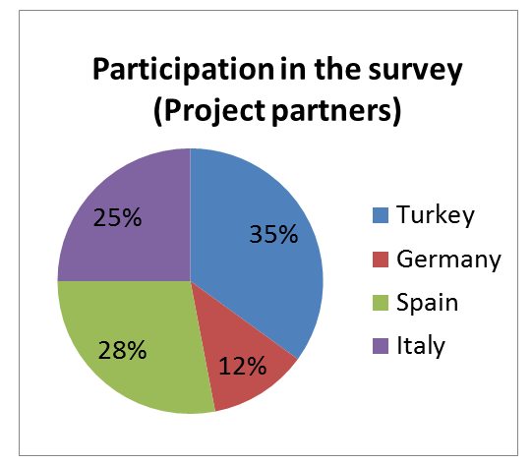
Current Situation Analysis of ECVET under the scope of our project
In order to measure the level of knowledge that managers and teachers have about the ECVET tool, 100 from Turkey, 283 projects from different categories of people from partner countries participated.

Slide 18
1) When asked whether ECVET is known or not;
Turkey
The Project Partners

Slide 19
2) Do you know why educational institutions use ecvet?
Turkey
The Project Partners

Slide 20
3) Have you ever done international mobility before?
Turkey
The Project Partners

Slide 21
Do you know the concepts of ECVET Learning Outcomes, Unit, Learning Agreement, Memorandum of Understanding, Qualifications, etc.
Turkey
Project Partner Countries

Slide 22
5) Do you use ECVET tools for your students?
Turkey
Project Partner Countries

Slide 23
6) Do you think that students and teachers need more knowledge about ECV tools?
Turkey
The Project Partners

Slide 24
7) Do you think that students and teachers need a guide to better understand the benefits of Ecvet and Ecvet?
Turkey
The Project Partners

Slide 25
8) Do you think an online platform will support the use of the ECVET tool?
Turkey
The Project Partners

Slide 26
Many projects that involves ECVET and which were granted by the national agency had the chance to be implemented.
Our project has significant intellectual output on ECVET.
Policy Document which will be created by the end of the project will have important contrbutions to the implementation of ECVET in partner countries

Slide 27
İzmir Provincial National Education
Research and Development Team
Serhat BARKA
Ayla SAVAŞÇI
Orhan ESKİTAŞ

